Slide 1


Muhammad Ryan 2101678844
Alfonsus Farel 2101699363
Joel Robert 2101629672
Final Presentation

Slide 2
Problem :
Harga produk fashion yang semakin tahun semakin meningkat berbanding terbalik dengan pemasukan masyarakat Kategori Mid to Low.
01
Efek Negatif yang ditimbulkan dari produksi produk fashion yang menganut sistem fast fashion
02
Keinginan masyarakat kategori Mid to Low untuk menggunakan produk fashion luxury brand
03

Slide 3
Solution :
Membuat Website untuk penyewaan produk fashion dengan menggunakan sistem C2C agar tiap individu dapat menyewa produk fashion
Selain menyewa produk, mereka dapat menyewakan produk fashion mereka agar dapat memperoleh pendapatan dari produk yang mereka miliki
NOW FASHION ISN'T LIABILITIES,
BUT ASSETS THAT CAN YOU MONITIZE

Slide 4
Business Model :
We take a 15% commission on each Transaction
Premium Subscription & Lite Subscription for Rent Customer
Average Fee 30K / 1 Day on each Transaction

Slide 5
Market Adoption ( Event )
Hari Raya Idul Fitri
Hari Raya Natal & Tahun Baru
Hari Raya Imlek
High Season & Harbolnas
Graduation & Wedding

Slide 6
Market Adoption (Partnership)
Fashion Designer
Fashion Social Media Group
Laundry & Cleaning Service

Slide 7
Product:
Website Ourwear

Slide 8
Tagline :
#TampilBedaSetiapSaat

Slide 9
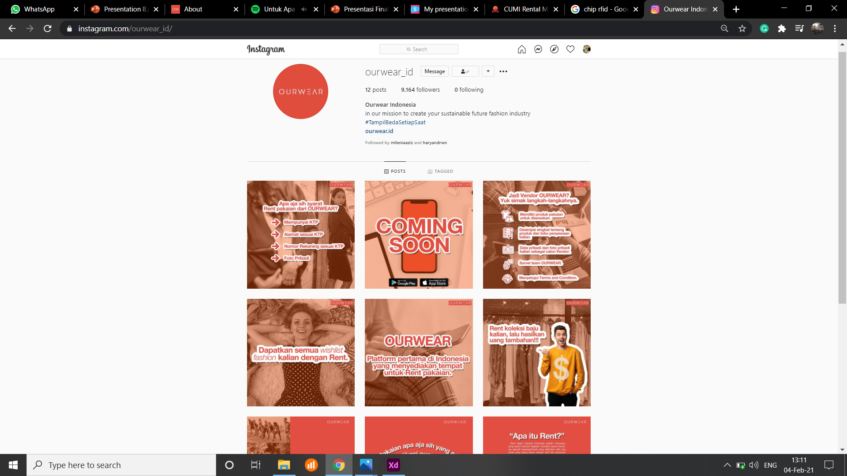
Instagram

Slide 10
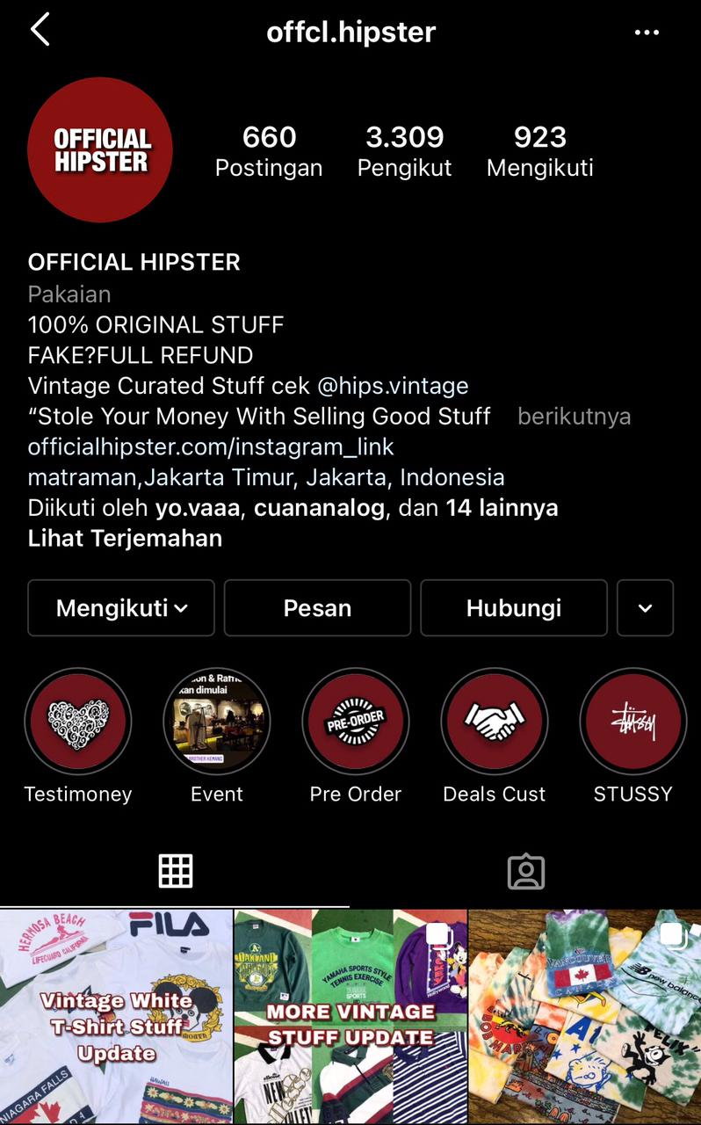
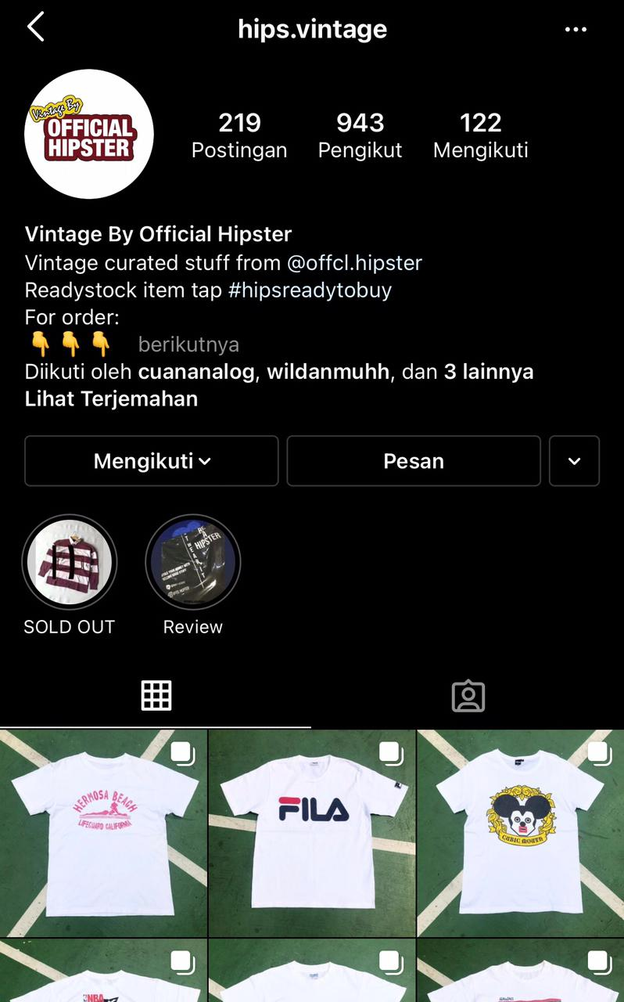
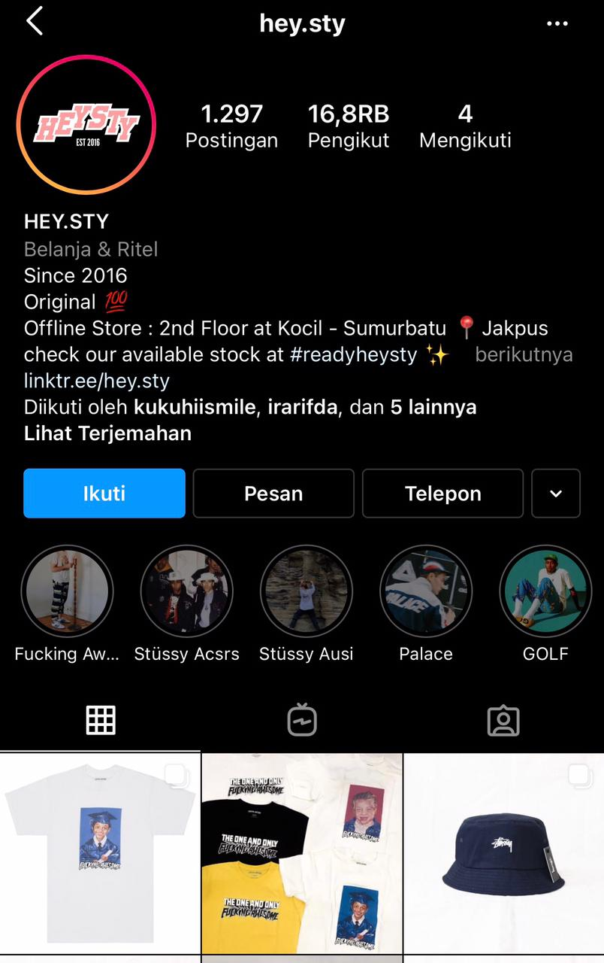
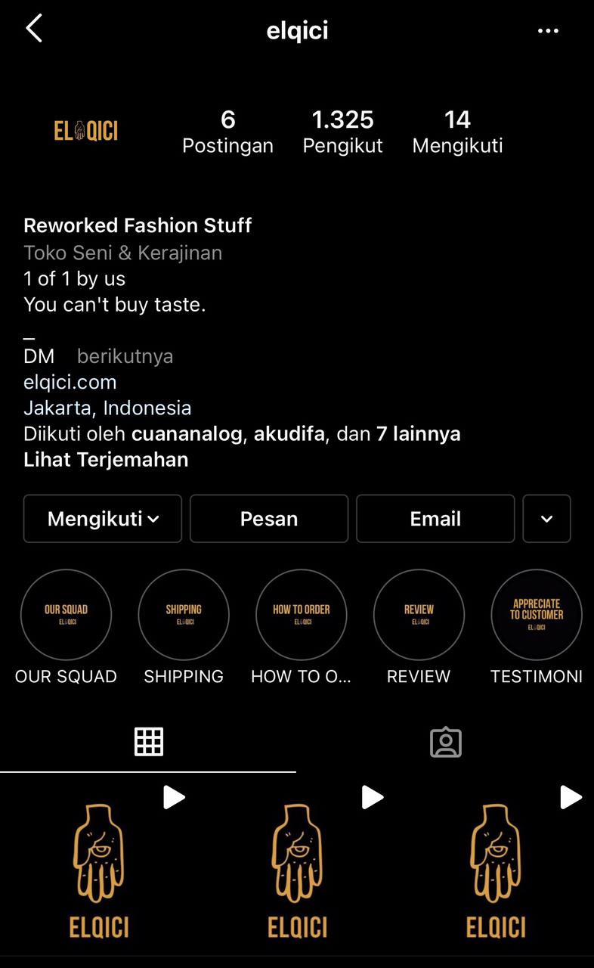
Vendor Clothings:

Slide 11

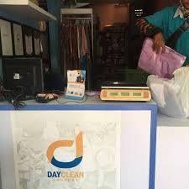
Vendor Laundry
Day Clean Laundry

Slide 12


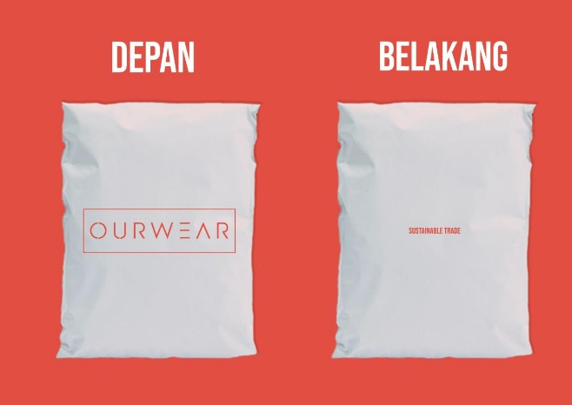
Packaging
BOX
DOORSLAG PAPER
ZIPPER PLASTIC BAG

Slide 13
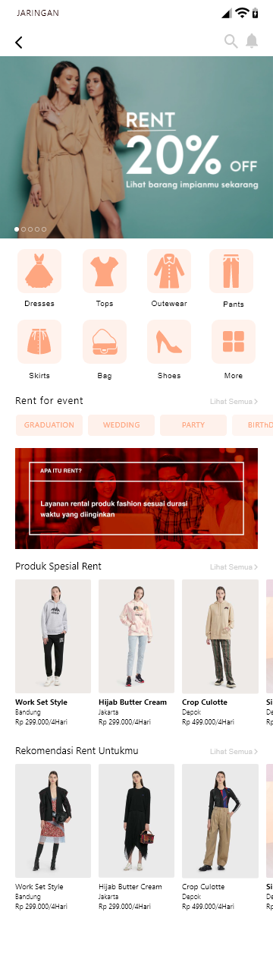
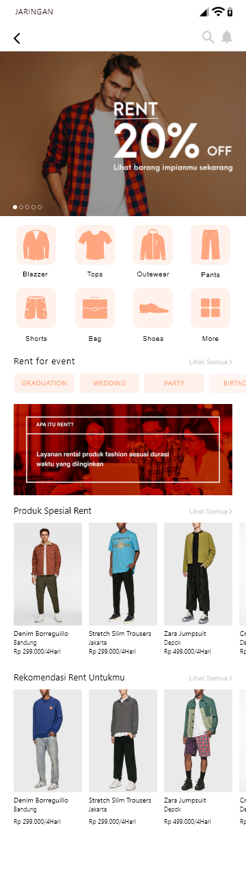
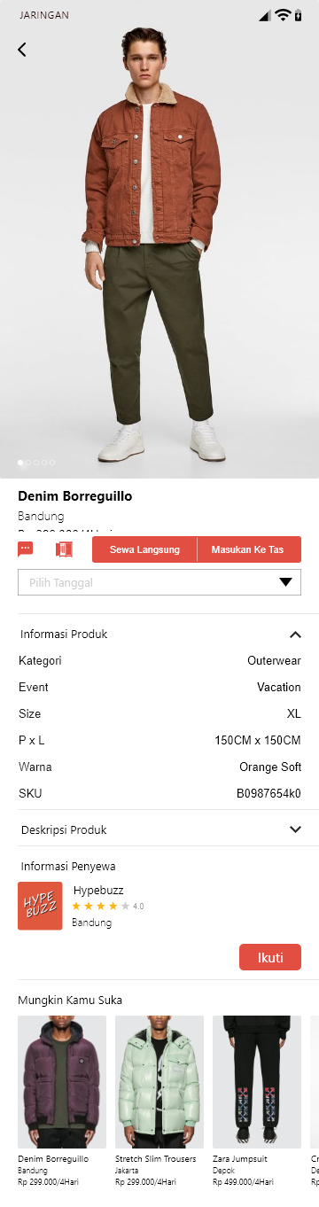
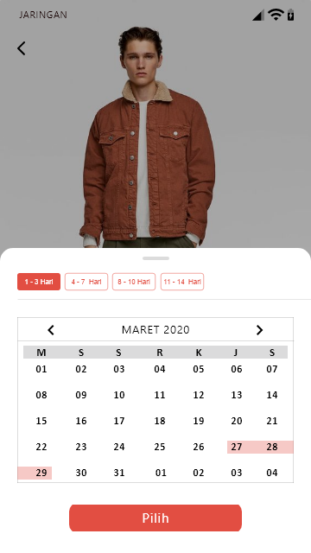
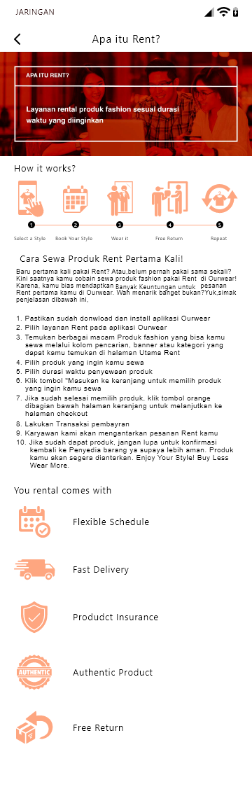
Coming Soon Product : Mobile App

Slide 14
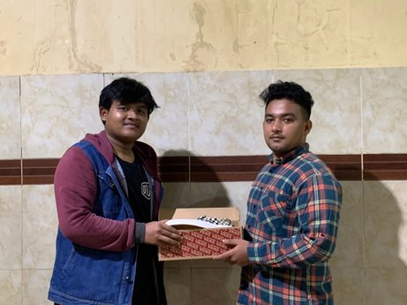
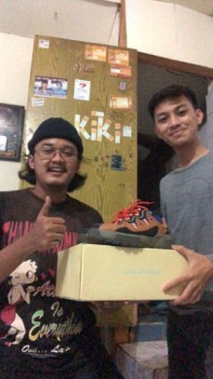
First Customer:

Slide 15
Competitors

Slide 16



Affordable
Offline Transaction
Online Transaction
Expensive

Slide 17
Competitive Advantage
First to Market
For transaction based on temporary rent C2C fashion Product
Ease of Use
Search by categories, booking dates, and book in 5 Click
Owner Incentive
They can make money from renting their fashion product
Clean Protocol
Cleaning product according to covid 19 Standarts

Slide 18


Team

